Slide 1
<number>

Slide 2
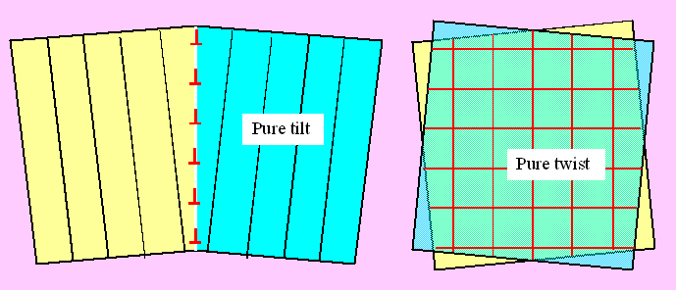
Low angle gbs: dislocation arrays

Slide 3
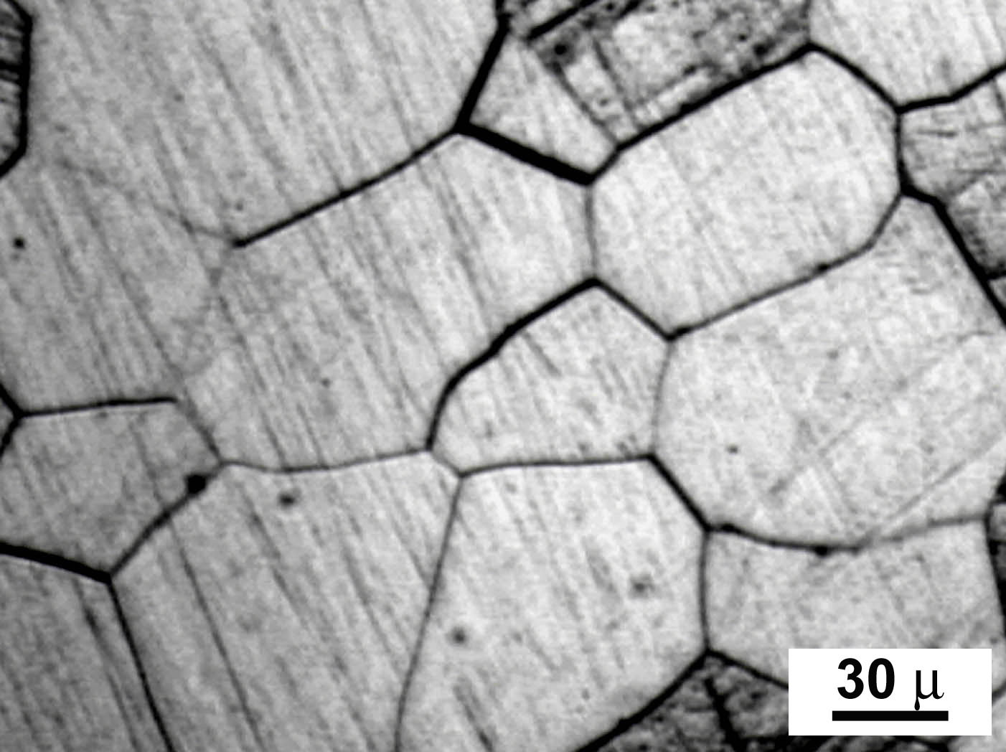
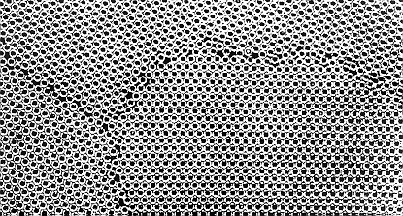
Grain Boundaries

Slide 4
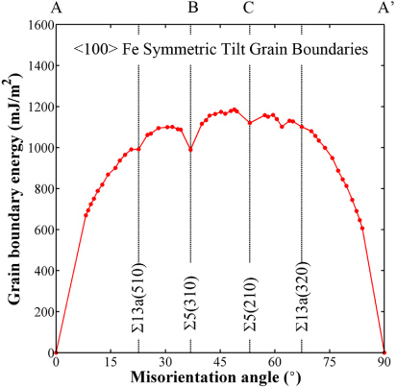
Grain boundary energies

Slide 5
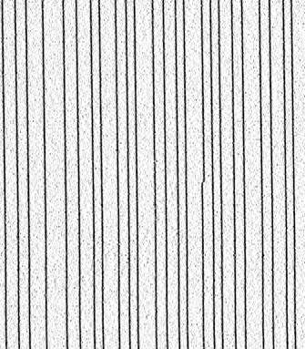
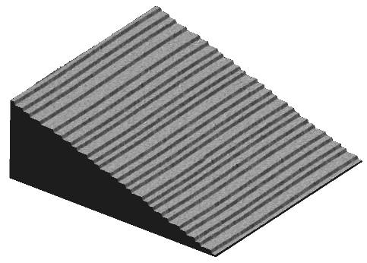
Steps and Kinks

Slide 6
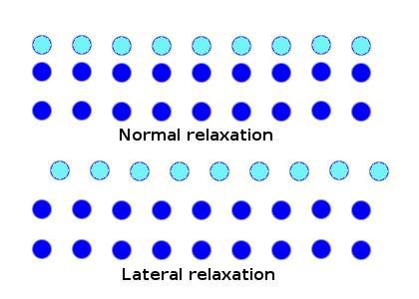
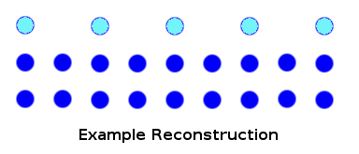
Surface reconstructions

Slide 7
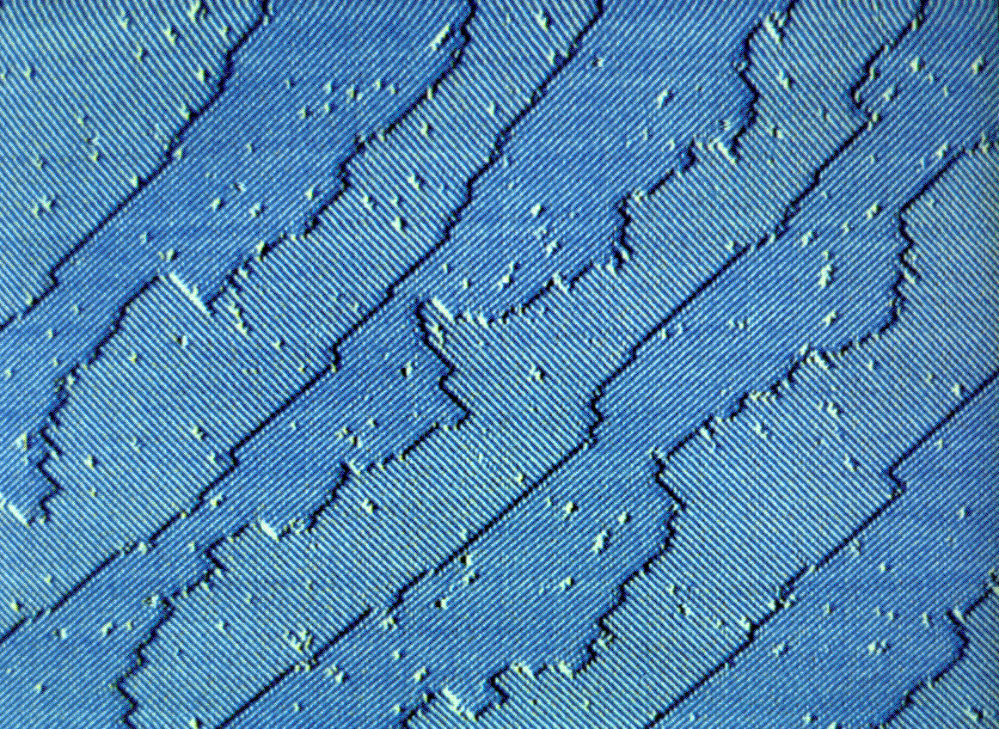
Si (001)

Slide 8
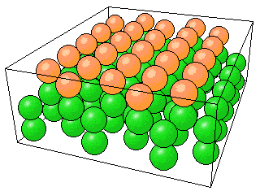
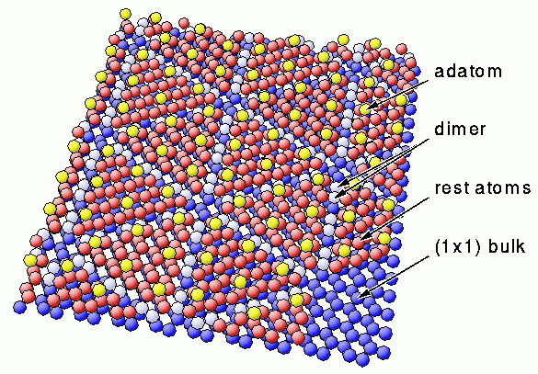
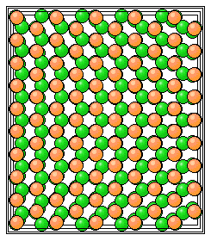
Si (111) 7x7 reconstruction

Slide 9
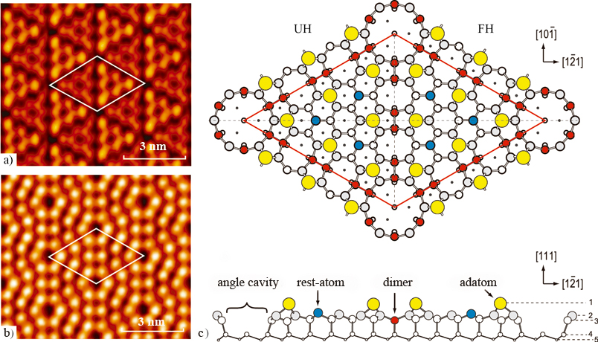
Si (111) 7x7 reconstruction

Slide 10
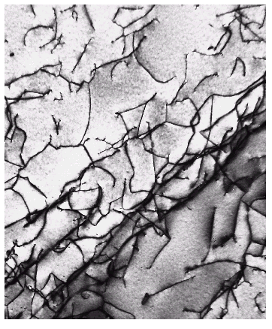
Imperfections in Solids
Dislocations are visible in electron micrographs: TEM
Looking down on
the top of a thin
metal film
Dislocations are the
dark lines, running
mostly from top to
bottom of the film
<number>
Notes:
<number>

Slide 11
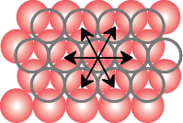
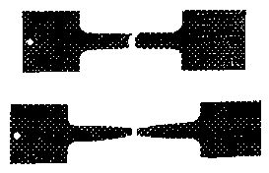
Dislocations, Slip Planes, & Crystal Structures
• Structure: close-packed
planes & directions
are preferred.
view onto two
close-packed
planes.
close-packed directions
close-packed plane (bottom)
close-packed plane (top)
• Comparison among crystal structures:
FCC: many close-packed planes (111)/directions [110];
HCP: only one (basal) plane, 3 directions;
BCC: none
• Specimens that
were tensile
tested.
Mg (HCP)
tensile direction
Al (FCC)
<number>
Notes:
<number>

Slide 12
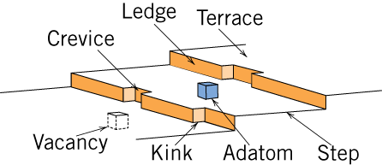
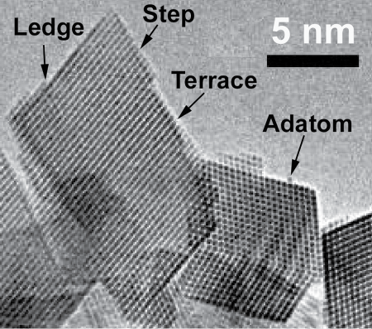
Catalysts and Surface Defects
A catalyst increases the rate of a chemical reaction without being consumed
Active sites on catalysts are normally surface defects
Fig. 4.11, Callister & Rethwisch 9e.
Single crystals of (Ce_{0.5}Zr_{0.5})O₂ used in an automotive catalytic converter
Fig. 4.12, Callister & Rethwisch 9e.
[From W. J. Stark, L. Mädler, M. Maciejewski, S. E. Pratsinis, and A. Baiker, “Flame Synthesis of Nanocrystalline Ceria/Zirconia: Effect of Carrier Liquid,” Chem. Comm., 588–589 (2003). Reproduced by permission of The Royal Society of Chemistry.]
<number>
Notes:
<number>

Slide 13
<number>

Slide 14
Changing grain size: additives (refiners)
Left: pure aluminum. Right: +0.2% Al-5Ti-1B refiner
<number>

Slide 15
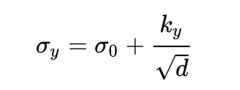
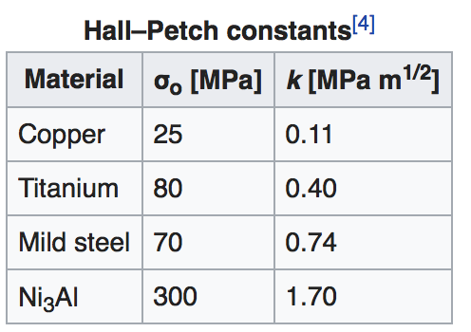
Effects on properties: Yield Stress
Grain boundaries cause dislocation pile-up
Hall-Petch equation
For larger grains, metals
get harder when grain size d
gets smaller
<number>

Slide 16
When grains are really small (~10 nm) the material softens (g.b. sliding?)
FCC Copper
Xiao et al., (2015): DOI: 10.1098/rspa.2014.0832
<number>
Notes:
<number>

Slide 17
Small amounts of impurities (dopants) added to crystalline, semiconducting silicon dramatically changes electrical properties
p-doping
holes
n-doping:
electrons
<number>

Slide 18
Field-Effect Transistor
A small voltage
change on the gate
dramatically changes
current flow from
source to drain
Electronic valve:
can be open, closed
Can be used as
an amplifier, logic gate,
memory
<number>

Slide 19
Understanding Defects: Microscopic Examination
Crystallites (grains) and grain boundaries. Vary considerably in size. Can be quite large
ex: Large single crystal of quartz or diamond or Si
ex: Aluminum light post or garbage can - see the individual grains
Crystallites (grains) can be quite small (mm or less) – necessary to observe with a microscope.
<number>
Notes:
<number>

Slide 20
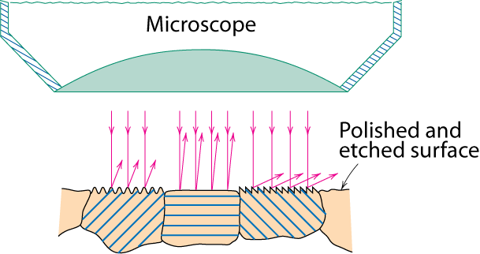
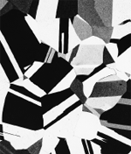
Optical Microscopy
• Useful up to 2000X magnification (~1 μm).
• Polishing removes surface features (e.g., scratches)
• Etching changes reflectance, depending on crystal
orientation.
crystallographic planes
Micrograph of
brass (a Cu-Zn alloy)
0.75mm
<number>
Notes:
<number>

Slide 21
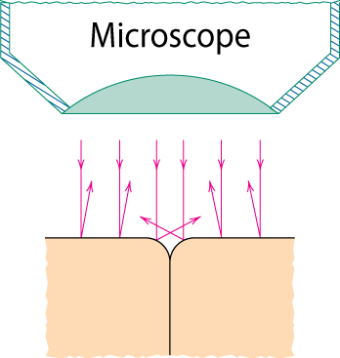
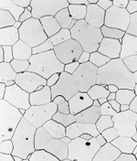
Optical Microscopy
Grain boundaries...
• are imperfections,
• are more susceptible
to etching,
• may be revealed as
dark lines,
• change in crystal
orientation across
boundary.
polished surface
surface groove
grain boundary
(a)
ASTM grain
size number
n
= 2
G
-1
Fe-Cr alloy
number of grains/in²
at 100x
(b)
magnification
<number>
Notes:
<number>

Slide 22
ASTM E 112-13
Standard for Determining Average Grain Size
Image analysis software: ImageJ from NIH
<number>

Slide 23
<number>

Slide 24
Optical Microscopy
Polarized light
metallographic scopes often use polarized light to increase contrast
Also used for transparent samples such as polymers
<number>
Notes:
<number>

Slide 25
Microscopy
Optical resolution ca. 10⁻⁶ m = 1 μm = 1000 nm
Wavelength of visible light: 400-700 nm
For higher resolution need small wavelengths
X-Rays? Wavelength: Cu Kα 0.154 nm (1.54 Ang)
Difficult to focus, scattering OK
Electrons
Electron beam focused by magnetic lenses
Voltages 5 kV : 100-400 kV : 1 MV
Wavelengths ~ 3 pm (0.003 nm)
Magnifications - 1,000,000X
Atomic resolution possible… approaching 0.05 nm (0.5 Ang)
Scanning EM (SEM): 1 kV – 30 kV
Transmission EM (TEM) : 200-400 kV
STEM
<number>
Notes:
<number>
Optical microscopy good to ca. wavelength of light
Higher frequencies
X-rays – good idea but difficult to focus
Electrons - wavelength proportional to velocity with high voltage (high acceleration) get wavelengths ca. 3pm (0.003nm) (x1,000,000)

Slide 26

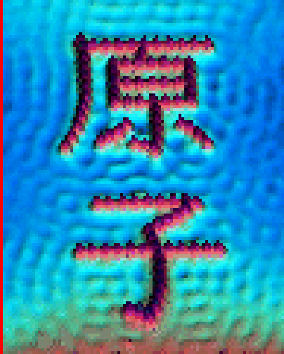
Scanned Probe Microscopies: Scanning Tunneling Microscopy (STM) Atomic Force Microscopy (AFM)
• Atoms can be arranged and imaged!
Iron atoms arranged on a copper (111) surface. These Kanji characters represent the word “atom”.
Carbon monoxide molecules arranged on a platinum (111) surface.
<number>
Notes:
<number>

Slide 27
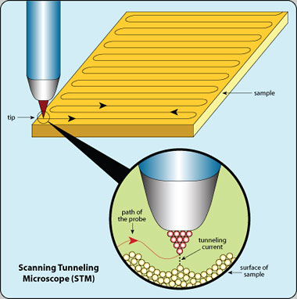
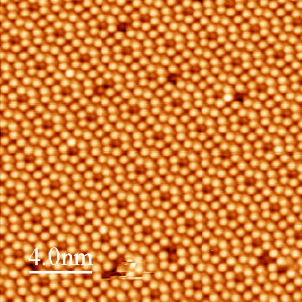
http://www.nisenet.org/publicbeta/articles/seeing_atoms/index.html
http://www.princeton.edu/~kahnlab/STMImages.
<number>

Slide 28
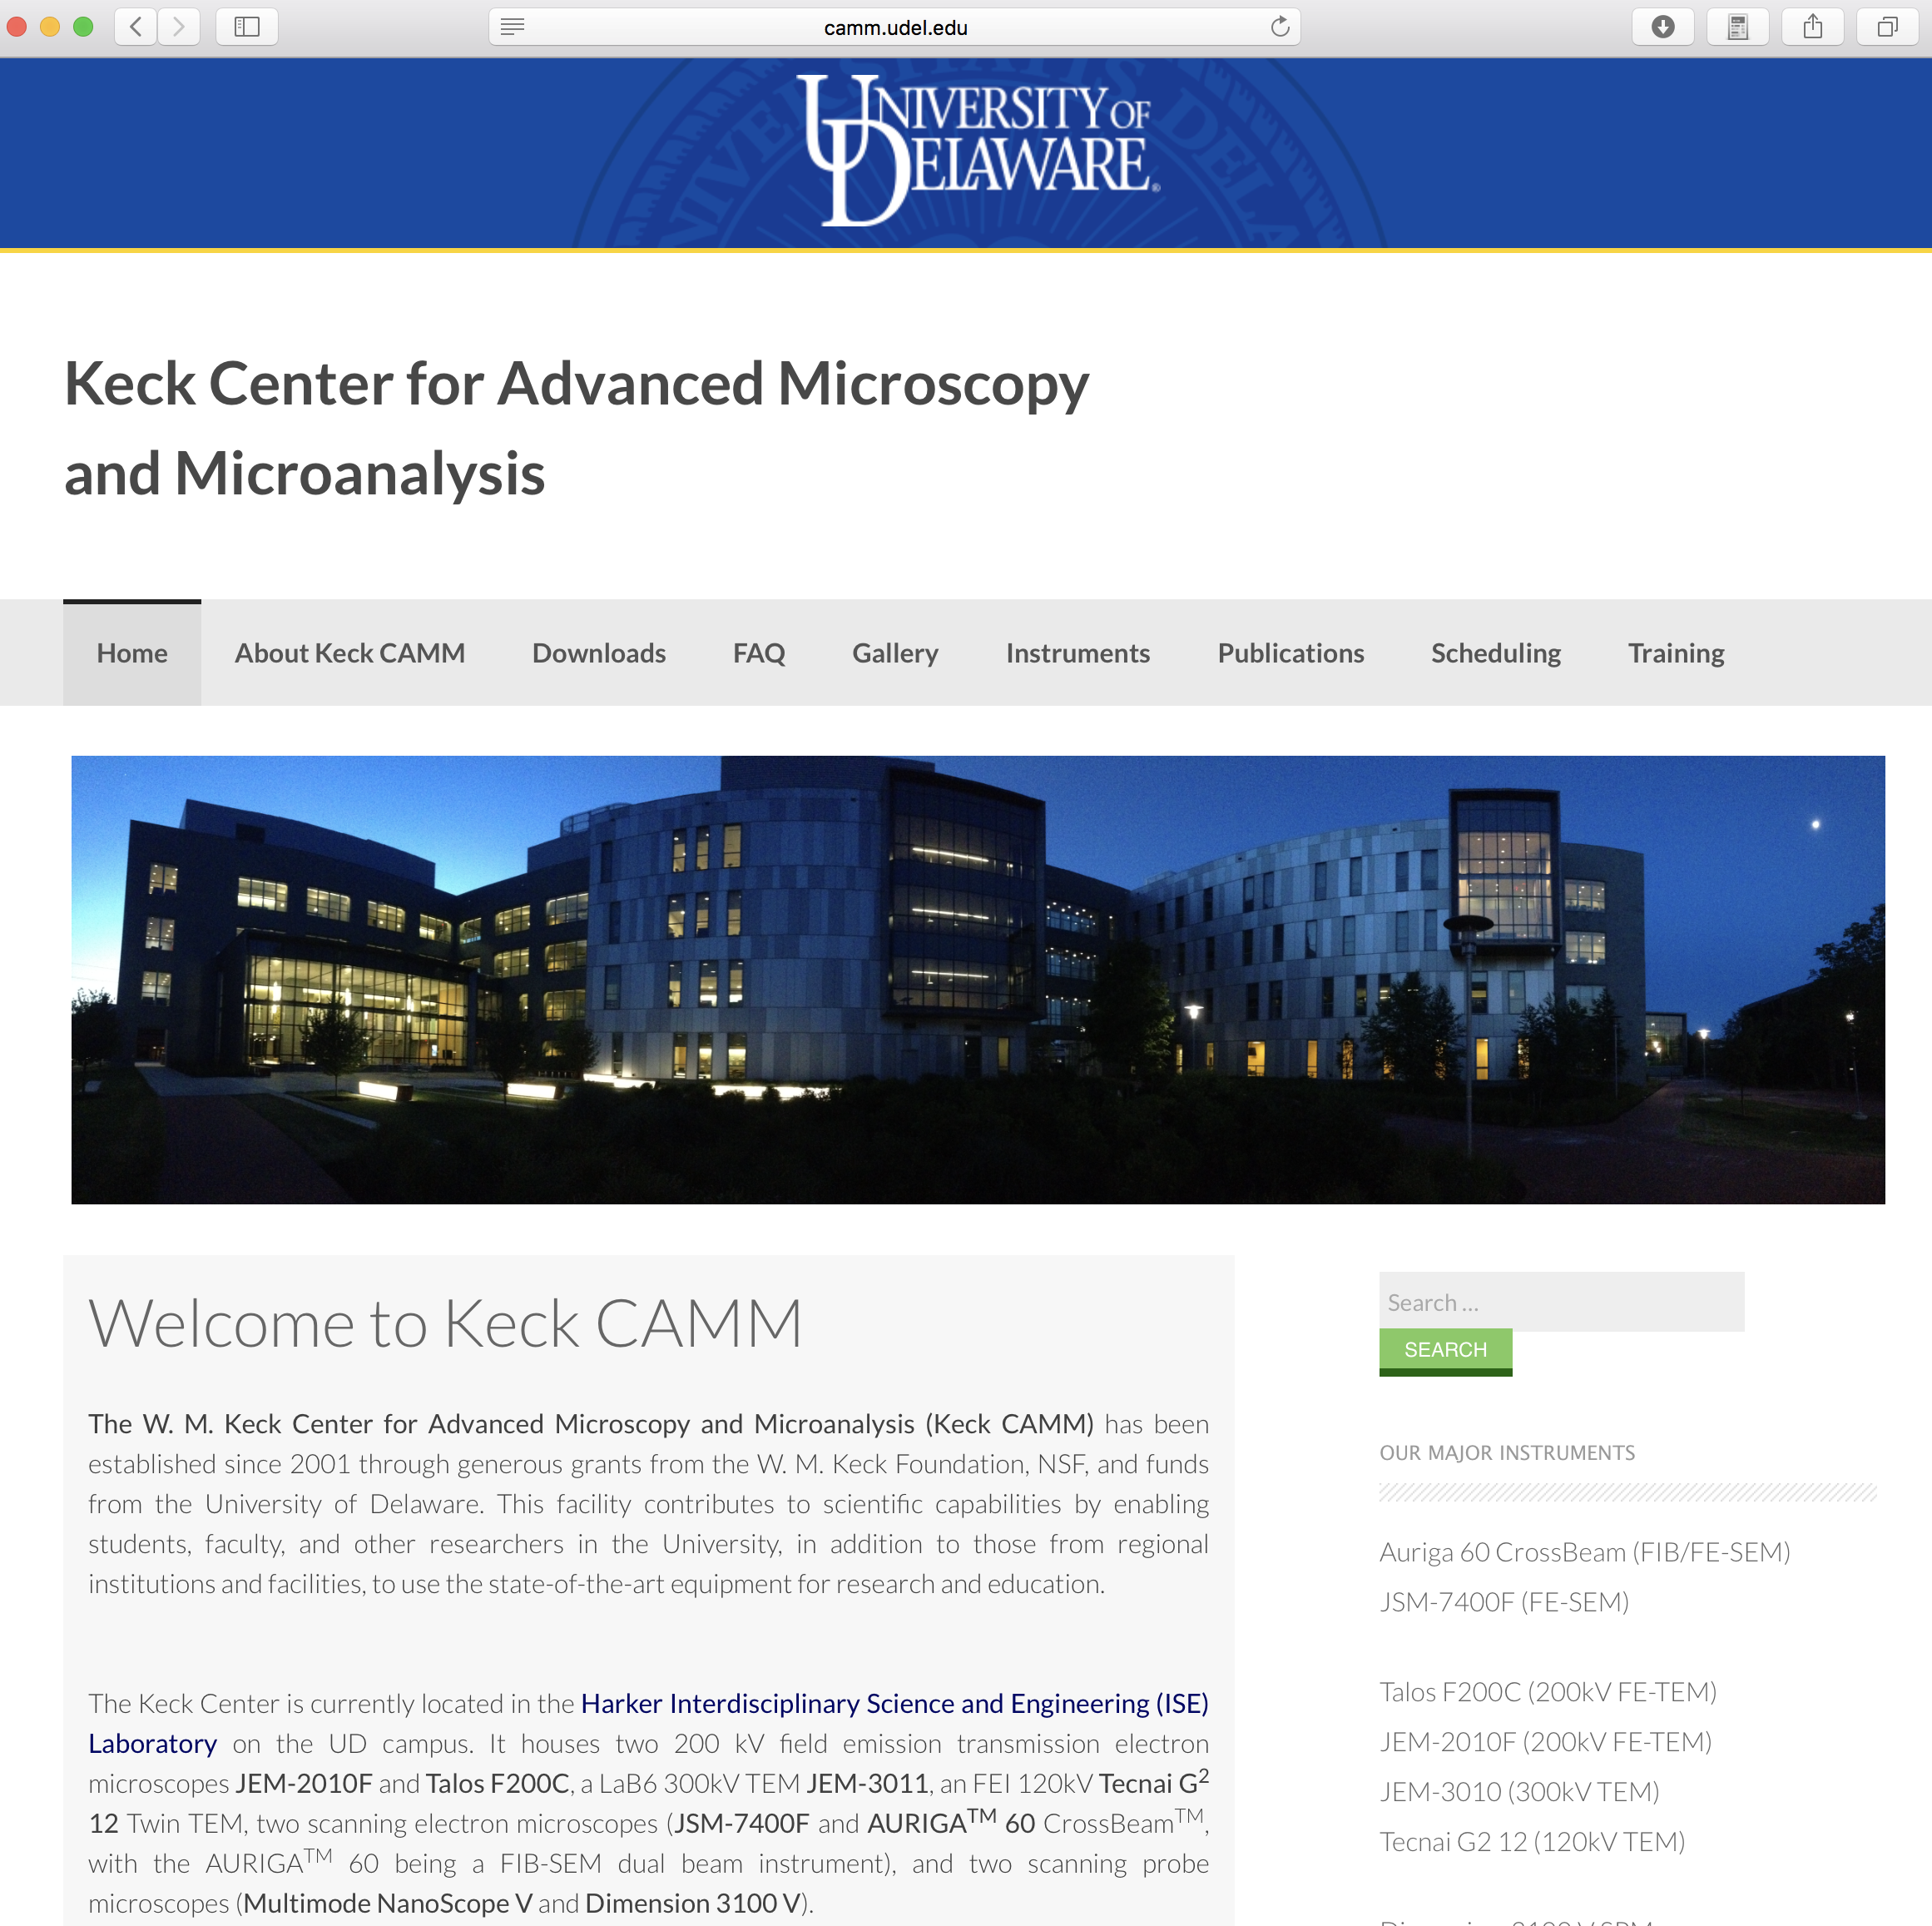
<number>

Slide 29
Zeiss Auriga 60 FIB/SEM
JEOL JSM-7400F SEM
FEI / ThermoSci Talos 200C STEM
<number>
JEOL JEM-3010 TEM
JEOL JEM-2010F STEM
FEI / ThermoSci Technai G2 12 TEM

Slide 30
https://www.quora.com/What-is-the-difference-between-the-SEM-microscope-and-the-STEM-microscope
<number>

Slide 31

<number>

Slide 32
X-ray Diffraction
Thermal Analysis
Porosity and Particle Size Analysis
Vibrational Spectroscopy
Mass Spectroscopy
http://sites.udel.edu/amcl/
<number>

Slide 33
Summary
• Point, Line, and Area defects exist in solids.
• The number and type of defects can be varied
and controlled (e.g., T controls vacancy conc.)
• Defects affect material properties (e.g., grain
boundaries control crystal slip).
• Defects may be desirable or undesirable
(e.g., dislocations may be good or bad, depending
on whether plastic deformation is desirable or not)
<number>
Notes:
<number>

Slide 34
Imperfections in Solids
Conditions for substitutional solid solution (S.S.)
W. Hume – Rothery rules
1. Δr (atomic radius) < 15%
2. Proximity in periodic table
i.e., similar electronegativities
3. Same crystal structure for pure metals
4. Valency
All else being equal, a metal will have a greater tendency to dissolve a metal of higher valency than one of lower valency
<number>
Notes:
<number>

Slide 35
Imperfections in Solids
Application of Hume–Rothery rules – Solid Solutions
1. Would you predict more Al or Ag to dissolve in Zn?
2. More Zn or Al
in Cu?
Element Atomic Crystal Electro- Valence Radius Structure nega- (nm) tivity
Cu 0.1278 FCC 1.9 +2 C 0.071 H 0.046 O 0.060 Ag 0.1445 FCC 1.9 +1 Al 0.1431 FCC 1.5 +3 Co 0.1253 HCP 1.8 +2 Cr 0.1249 BCC 1.6 +3 Fe 0.1241 BCC 1.8 +2 Ni 0.1246 FCC 1.8 +2 Pd 0.1376 FCC 2.2 +2 Zn 0.1332 HCP 1.6 +2
<number>
Notes:
<number>

